Slide 1
Final Review

Slide 2
Materials
The final exam is comprehensive
More questions on the third part
Time and Location
CS4321 | R01 | Monday | 3pm |  | 214

Slide 3
Topics For Exam 1
Topics | Reading
Introduction | 1.1-1.3
Induction and Loop invariants | 1.4-1.7, GT 1.3
Elementary Algorithmics | Chapter 2
Asymptotic Notation | Chapter 3
Algorithm Analysis - Analyzing control structures - Worst-case and Average-case - Amortized analysis | 4.1-4.6
Solving Recurrences | 4.7
Exam 1

Slide 4
Topics for Exam 2
Topics | Reading
Heap and Heap Sort | 5.1-5.7
Binomial Heaps | 5.8
Binary search tree, Splay Trees | GT 3.1, 3.4
Disjoint Set | 5.9
Greedy Algorithms - Coin Change - Minimum Spanning Tree - Dijkstra’s algorithm - Knapsack - Scheduling | 6
Divide-and-Conquer - Mergesort and quicksort - Median - Strassen’s algorithm - Closest pair | 7

Slide 5
Topics After Exam 2
Topics | Reading
Dynamic Programming - Binomial coeffcient, coin change - 0-1 Knapsack - Floyd’s algorithm - Matrix chain | Chapter 8
Exploring Graphs - Graph Search - Topological sorting - Brand and Bound | Chapter 9
Network Flow | GT 8.1-8.3
Decision Trees and Low Bound Arguments | 12.1-12.3
P and NP Problems | 12.4-12.6, 13.2

Slide 6
Study Guide
Study the reviews for Exams 1 and 2
Study the questions on first two exams
Understand how the covered algorithms work

Slide 7
Dynamic Programming
Given a problem, know how to design a dynamic programming algorithm
Know how to analyze a DP algorithm
Know the following algorithms
  Calculating Binomial Coefficient
  Coin Change
  0-1 Knapsack
  Floyd’s algorithm
  Matrix chain

Slide 8

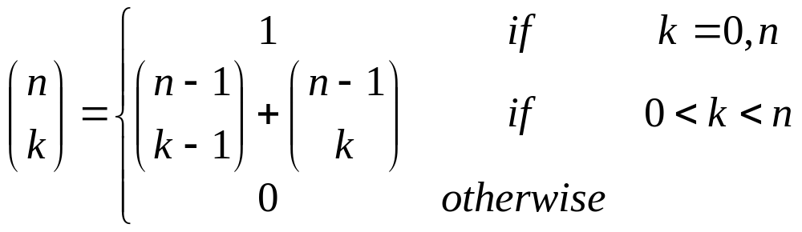
Example: Binomial Coefficient
We want to calculate which can be defined as follows.

Slide 9
A solution using dynamic programming
We instead calculate bottom-up by filling the following table
n k | 0 | 1 | 2 | ……. | k-1 | k
0 | 1
1 | 1 | 1
2 | 1 | 2 | 1
n-1 |  |  |  |  | C(n-1,k-1) | C(n-1,k)
n |  |  |  |  |  | C(n.k)
…
Cost: time Θ(nk) and space Θ(k)

Slide 10
Make change
The principle of optimality
  In an optimal sequence of decisions or choices, each subsequences must be also optimal
Making a change
  c[i,j] is an optimal solution to for making a change of j using the first i denominations
    If at lease one coin of denomination i is used, then
    c[i, j]=c[i, j-d_{i}]+1
    Otherwise, c[i, j]=c[i-1, j]
    We obtain c[i,j]=min(c[i-1, j], c[i, j-d_{i}]+1)

Slide 11
Example
Pay 8 units with coins worth 1, 4, and 6 units.
Construct the following table top-down, left to right.
Amount | 0 | 1 | 2 | 3 | 4 | 5 | 6 | 7 | 8
d1=1 | 0 | 1 | 2 | 3 | 4 | 5 | 6 | 7 | 8
d2=4 | 0 | 1 | 2 | 3 | 1 | 2 | 3 | 4 | 2
d3=6 | 0 | 1 | 2 | 3 | 1 | 2 | 1 | 2 | 2
c[3,8] = min(c[2,8], c[3,8-6]+1) = min(2, 3) = 2
c[2,8] = min(c[1,8], c[2,4]+1) = min(8, 2)=2
c[2,4] = min(c[1,4], c[2,0]+1) = min(4, 1) =1
The optimal solution 2. The greedy algorithm returns 3.

Slide 12
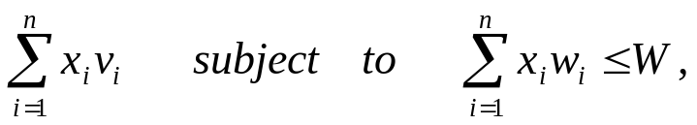
0-1 Knapsack
  n objects 1, 2, ..., n. Object i has weight w_{i} and value v_{i}
  The knapsack can carry a weight not exceeding W.
  Cannot split an object
  Maximize the total value
    Maximize
    where v_{i} , w_{i} > 0 and x_{i}  {0,1} for 1 <= i< =n

Slide 13
By dynamic programming
Set up a table C[0..n, 0..W] with one row for each available object and one column for each weight from 0 to W. Specifically, C[0, j] = 0 for all j.
C[i,j] is the maximum value if the weight limit is j and only objects 1 to i are available
  C[i,j] = max(C[i-1,j], C[i-1, j-w_{i}]+v_{i});
C[n,W] will be the solution

Slide 14
Algorithm
Knapsack0-1(v, w, n, W)
{
for (w = 0; w<=W; w++) {
c[0,w] = 0;
}
for (i=1; i <=n; i++) {
c[i,0] = 0
for (w=1; w<=W; w++) {
if (w[i] < w) {
if (c[i-1,w-w[i]]+v[i] > c[i-1,w])
c[i,w] = c[i-1,w-w[i]] + v[i];
else c[i,w] = c[i-1,w]
} else c[i,w] = c[i-1,w]
} // for w
} for i
}
The run time performance of this algorithm is Θ(nW)

Slide 15
Finding the objects
i=n;
k=W;
while (i>0 && k>0) {
if (C[i,k] <> C[i-1,k]) {
mark the i-th object as in knapsack;
k = k-w[i];
i = i-1;
} else
i = i-1;
}
Cost: O(n+W)

Slide 16
Floyd’s algorithm
Floyd(int L[1..n][1..n])
{
D = L;
P = 0;
for (k=1; k<=n; k++)
for (i=1; i<=n; i++)
for (j=1; j<=n; j++)
if (D[i][k]+D[k][j] < D[i][j]) {
D[i][j] = D[i][k]+D[k][j];
P[i][j] = k;
}
}
Track the
shortest path
Cost: Θ(n³)
Why can we use just one array D?

Slide 17
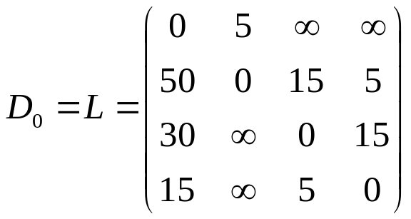
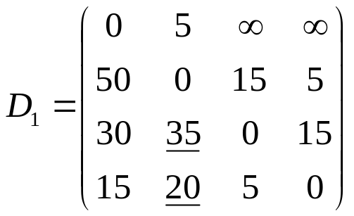
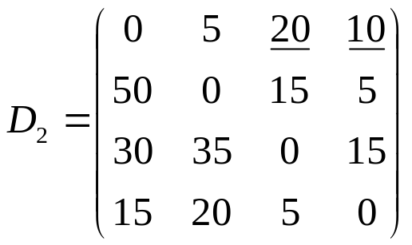
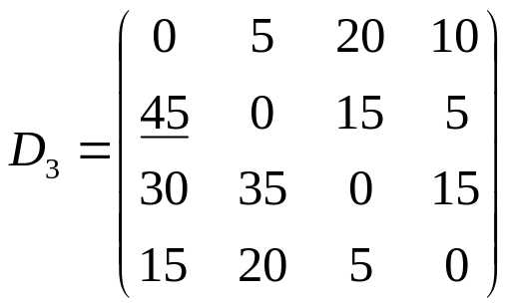
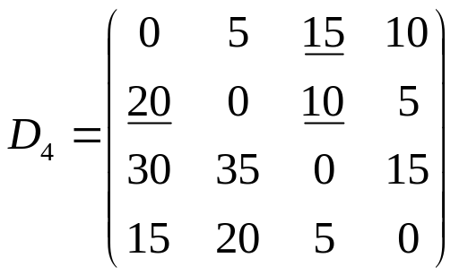
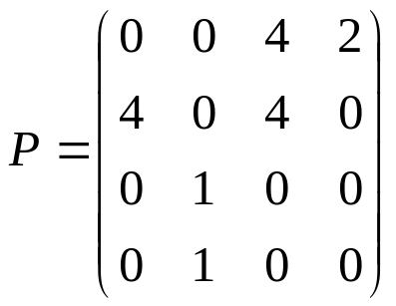
Example
15
1
4
30
5
5
50
5
15
2
3
15

Slide 18
Find the shortest path
// Print shortest path between
nodes i and j
printShortestPath(int i, int j)
{
print i;
printIntermediateNodes(i, j);
print j;
}
// Print intermediate nodes in the shortest
path between nodes i and j
printIntermediateNodes(int i, int j)
{
int k = p[i][j];
if (k == 0)
return;
else {
printIntermediateNodes(i, k);
print k;
printIntermediateNodes(k, j);
}
}
Find the shortest path between nodes 1 and 3 for the example.

Slide 19
Chained Matrix Multiplication
Problem
  Find an optimal parenthesization of chained matrix multiplication
Chained matrix multiplication
  M = M₁M₂…M_{n}
Parenthesization
  A product of matrices is fully parenthesized if it is either a single matrix or the product of two fully parenthesized matrix products, surrounded by parentheses

Slide 20
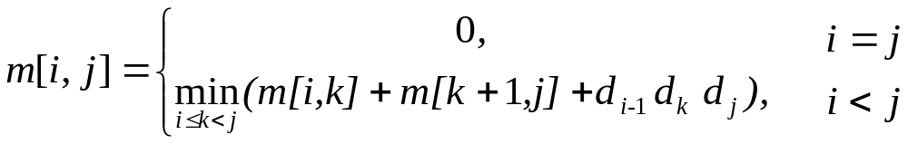
A recursive equation
Let m[i,j] be the minimum number of scalar multiplications needed to compute M_{i..j}
  The cost for is M_{1..n} is m[1,n]
Assume that the optimal parenthesization splits the product M_{i}M_{i+1}…M_{j} between M_{k} and M_{k+1}
  Based on the principle of the optimality
  m[i,j] = m[i,k]+m[k+1,j]+d_{i-1} d_{k} d_{j}
  We obtain the following recurrence

Slide 21
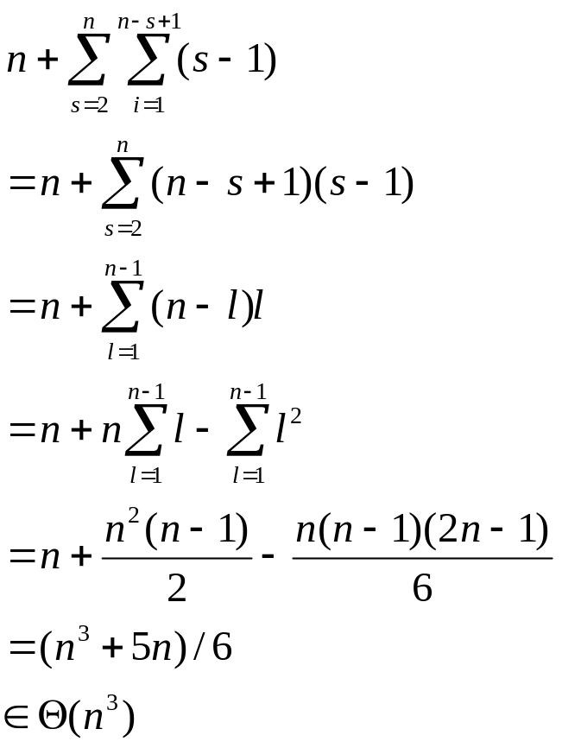
An implementation using dynamic programming
Cost:
matixChain()
{
for (i=1; i<=n; i++) // sequence of length 1
m[i][i]=0;
for (s=2; s<=n; s++) // s is the length of the sequence
for (i=1; i<=n-s+1; i++) {
j = i+s-1;
m[i][j] = ;
for (k=i; k<=j-1; k++)
tmp = m[i,k]+m[k+1,j]+d[i-1]d[k]d[j]
if (tmp < m[i][j]) {
m[i][j] = tmp;
p[i][j] = k; // split point
}
}
}

Slide 22
Example
M1 | 135
M2 | 589
M3 | 893
M4 | 334
j
 | 1 | 2 | 3 | 4
1 | 0 | 5785 | 1530 | 2856
2 |  | 0 | 1335 | 1845
3 |  |  | 0 | 9078
4 |  |  |  | 0
i
m[1][3]=min(m[1][1]+m[2][3]+13*5*3, m[1][2]+m[3][3]+13*89*3)=min(1530,9256)=1530
m[2][4]=min(m[2][2]+m[3][4]+5*89*34, m[2][3]+m[4][4]+5*3*34)=min(24208,1845)=1845
min[1][4]=min(m[1][1]+m[2][4]+13*5*34, k=1
m[1][2]+m[2][4]+13*89*34, k=2
m[1][3]+m[4][4]+13*3*34) k=3
=min(4055, 54201, 2856) = 2856

Slide 23
Graph Traversal
Know the depth search, breadth search, and topological sort algorithms
Know how to use graph search to solve problems
Topics
  Tree traversal
  Preconditioning
    find ancestor in a tree
  Graph search
    Breadth first
    Depth first
      Articulation points (not required)
      Topological sort

Slide 24
Graph search: some concepts
To keep track of progress, graph search colors each node white, gray, or black
  All nodes start with white
  A node is discovered at the first time it is encountered during the search, at which time it becomes non-white
  Different search distinguishes itself by a different way to blacken or gray nodes

Slide 25
Breadth-first search
Given a graph G=<N, E>, and a source node, s, start breadth-first search from s.
Expands the frontier between discovered and undiscovered nodes uniformly across the breadth of the frontier
  Discovers all nodes at distance k from s before discovering any nodes at distance k+1.
Coloring: if (u,v)  E and vertex u is black, then node v is either black or gray
  Black node: discovered and the node itself is finished
  Gray node: discovered but not finished

Slide 26
Breadth-first search algorithm
BFS(G,s)
{
for each node u  N – {s} {
color[u] = WHITE;
d[u] = ;
[u] = null;
}
color[s] = GRAY;
d[s] =0
enqueue(Q, s);
while (!empty(Q)) {
u = dequeue(Q);
for each v adjacent to u {
if (color[v] == WHITE) {
color[v] = GRAY;
d[v] = d[u] + 1;
[v] = u;
enqueue(Q, v);
}
}
color[u] = BLACK;
}
d[]: tracks shortest distance, assuming each edge’s weight is 1
[]: tracks the parent-child relationship in the breadth-first tree

Slide 27
Depth-first search
Search deeper in the graph whenever possible
  Edges are explored out of the most recently discovered node v that still has undiscovered edges leaving it
  When all of v’s edges have been explored, the search “backtracks” to explore edges leaving the vertex from which v was discovered
  This process finishes until all nodes reachable from the original source are discovered
  Select one undiscovered node as the new source and continue the process

Slide 28
Depth-first search coloring and time stamps
Coloring
  Each nodes is initially white
  A node is grayed if it is discovered during the search and blackened if it is finished, that is, when its adjacency list has been examined completely
Timestamps
  Each node v has two timestamps
    d[v] records when v is discovered (grayed)
    f[v] records when v is finished (blackened)

Slide 29
Depth-first search algorithm
DFS(G)
{
for each node u  N {
color[u] = WHITE;
[u] = null;
}
time = 0;
for each node u  N {
if (color[u] == WHITE)
DFS-Visit(u);
}
}
DFS-Visit(u)
{
color[u] = GRAY;
d[u] = ++time;
for each v adjacent to u {
if (color[v] == WHITE) {
[v] = u;
DFS-Visit(v)
}
}
color[u] = BLACK;
f[u] = ++time;
}

Slide 30
Classification of graph edges
After depth-first search of a directed graph, we can classify the graph edges into four categories
  Tree edge
    An edge in the search tree
  Back edge
    An edge (u,v) not in search tree and v is an ancestor of u
    Indicates a loop
  Forward edge
    An edge (u,v) not in search tree and u is an ancestor of v
  Cross edge
    An edge (u,v) not in search tree and v is neither an ancestor nor a descendant of u

Slide 31
Example: depth-first search directed graph
1
12
1
Tree edge
Forward edge
Back edge
Cross edge
3
4
2
2
5
3
6
4
11
14
8
9
7
10
13
16
6
15
7
8
5

Slide 32
Topological Sort
Given an acyclic directed graph, topological sort finds a topological ordering of the nodes such that if there exists an edge (u,v), then node u precedes node v in the ordering list.
The finished time numbering gives us a reverse topological ordering
  A node is finished after all the nodes it reaches have finished

Slide 33
Branch-and-Bound
Not required

Slide 34
Maximum Flow Problem
Given a weighted directed graph
  Each edge is a pipe whose weight denotes its capacity: the maximum amount it can transport
    Use c(e) for the capacity of edge e
  Given a source, s, and a sink, t, find the maximum amount (flow) can transfer from s to t
2
7
1
4
6
1
5
s
5
3
3
t
3
6
8
9
2
5

Slide 35
Concepts
You need to know the follow concepts
  Flow of a network
  Capacity and flow of an edge
  Cut
    Capacity and flow of a cut
  Residual capacity of an edge and a path
  Augmenting Path
    Residual capacity

Slide 36
Example of the Ford-Fulkerson Algorithm
0/1
1
3
2/2
0/1
0/2
1/1
1/2
2/4
s
0/1
4
2
t
3/4
1/2
2/4
2
5
0/1
2/2

Slide 37
Example of the Ford-Fulkerson Algorithm
1/1
1
3
2/2
1/1
0/2
0/1
1/2
3/4
s
1/1
4
2
t
3/4
1/2
2/4
2
5
0/1
2/2

Slide 38
The Ford-Fulkerson Algorithm
maxFlowFordFulkerson(N)
// N =(G, c, s, t)
{
for each edge e in N do {
f(e) = 0;
stop = false;
}
while (!stop) {
traverse G starting at s to find an augmenting path for f;
if an augmenting π path exists {
Δ = minimum Δ_{f}(e) along π;
for each edge e in π {
if (e is an forward edge) f(e) += Δ; else f(e) -= Δ;
}
} else
stop = true;
}
}

Slide 39
Complexity
Arguing a lower bound
  Information-theoretic arguments
Given a comparison based problem
  Know how to construct a decision tree
  Know how to argue the lower bound using decision tree
  Adversary arguments
Proof equivalence of complexity or compare complexity
  Linear reductions
  NP-completeness

Slide 40
Information-theoretic arguments
Particularly applies to those problem involving comparisons
Uses a decision tree to represent the working process of an algorithm on all possible data of a given size
  A decision tree is a binary tree where
    Each internal node contains a test on the data
    Each leaf contains an output, called verdict
    A trip through the tree starts from the root and recursively goes to the left subtree or the right subtree depending on whether the answer to the root is “yes” or “no”
    The trip ends when it reaches a leaf (verdict)

Slide 41
A decision tree for sorting
A<B
Y
N
B<C
B<C
N
Y
N
Y
A<B<C
A<C
A<C
C≤B≤A
Y
N
Y
N
A<C≤B
C≤A<B
B≤A<C
B<C≤A
Note that the number of leaves = The number of possible outputs

Slide 42
Insertion Sort
void insertionSort(int A[], int n)
{ // array index starts from 1 here
int i, j, x;
for (i=2; i<=n; i++) {
x =A[i];
j = i-1;
while (j>0 && x<A[j]) {
A[j+1] = A[j];
j--;
}
A[j+1] = x;
}
}

Slide 43
A three-item insertion sort decision tree
B<A
Y
N
ABC
BAC
C<A
C<B
Y
Y
N
BAA, x=C
ABB, x=C
N
C<B
BAC
C<A
ABC
Y
N
Y
N
CBA
BCA
CAB
ACB
C<B<A
B≤C<A
B<A≤C
C<A≤B
A≤C<B
A≤B≤C

Slide 44
Observations
The number possible outputs = The number of leaves (verdicts)
The worst-case time is the height of the tree
The average time is the average depth of leaves assuming equal distribution

Slide 45
Theorem
Any binary tree with k leaves has an average height of at least lg k
Any comparison-based algorithm takes a worst case time and average case time (n log n)

